Slide 1
Transformation In 2-Dimension
Course Title: Computer Graphics
Course Code: CSE – 413
Instructor: Syed Shakil Mahmud, Lecturer, Dept. of CSE(BAIUST)

Slide 2
Introduction of Transformations
Computer Graphics provide the facility of viewing object from different angles. The architect can study building from different angles i.e.
Front Evaluation
Side elevation
Top plan
A Cartographer can change the size of charts and topographical maps. So if graphics images are coded as numbers, the numbers can be stored in memory. These numbers are modified by mathematical operations called as Transformation.
The purpose of using computers for drawing is to provide facility to user to view the object from different angles, enlarging or reducing the scale or shape of object called as Transformation.
Two essential aspects of transformation are given below:
Each transformation is a single entity. It can be denoted by a unique name or symbol.
It is possible to combine two transformations, after connecting a single transformation is obtained, e.g., A is a transformation for translation. The B transformation performs scaling. The combination of two is C=AB. So C is obtained by concatenation property.
There are two complementary points of view for describing object transformation.
Geometric Transformation: The object itself is transformed relative to the coordinate system or background. The mathematical statement of this viewpoint is defined by geometric transformations applied to each point of the object.
Coordinate Transformation: The object is held stationary while the coordinate system is transformed relative to the object. This effect is attained through the application of coordinate transformations.

Slide 3
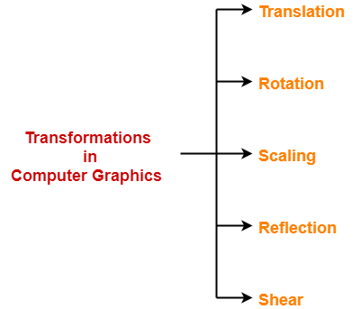
An example that helps to distinguish these two viewpoints:
The movement of an automobile against a scenic background we can simulate this by
Moving the automobile while keeping the background fixed-(Geometric Transformation)
We can keep the car fixed while moving the background scenery- (Coordinate Transformation)
Types of Transformations:
Translation
Scaling
Rotating
Reflection
Shearing
2D Transformation in Computer Graphics-
Definition-1: In Computer graphics,
Transformation is a process of modifying and re-positioning the existing graphics.
Definition-2: 2D Transformations take place in a two dimensional plane.
Transformations are helpful in changing the position, size, orientation, shape etc of the object.

Slide 4
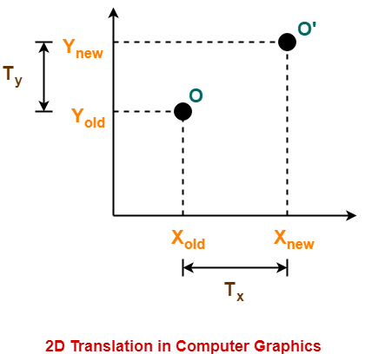
2D Translation in Computer Graphics-
In Computer graphics,
2D Translation is a process of moving an object from one position to another in a two dimensional plane. The movement of objects without deforming the shape of the object is Translation.
Consider a point object O has to be moved from one position to another in a 2D plane.
Let-
Initial coordinates of the object O = (X_{old}, Y_{old})
New coordinates of the object O after translation = (X_{new}, Y_{new})
Translation vector or Shift vector = (T_{x}, T_{y})
Given a Translation vector (T_{x}, T_{y})-
T_{x} defines the distance the X_{old} coordinate has to be moved.
T_{y} defines the distance the Y_{old} coordinate has to be moved.

Slide 5
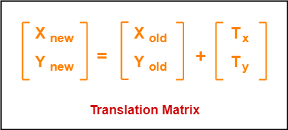
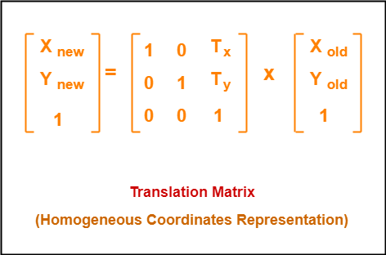
This translation is achieved by adding the translation coordinates to the old coordinates of the object as-
X_{new} = X_{old} + T_{x} (This denotes translation towards X axis)
Y_{new} = Y_{old} + T_{y} (This denotes translation towards Y axis)
In Matrix form, the above translation equations may be
represented as-
The homogeneous coordinates representation of (X, Y) is (X, Y, 1).
Through this representation, all the transformations can be performed using matrix / vector multiplications.
The above translation matrix may be represented as a 3 x 3 matrix as-

Slide 6
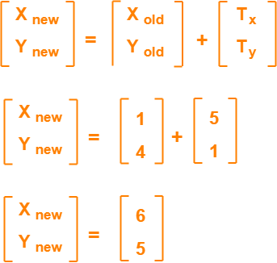
PRACTICE PROBLEMS BASED ON 2D TRANSLATION IN COMPUTER GRAPHICS-
Problem-01:
Given a circle C with radius 10 and center coordinates (1, 4). Apply the translation with distance 5 towards X axis and 1 towards Y axis. Obtain the new coordinates of C without changing its radius.
Solution-
Old center coordinates of C = (X_{old}, Y_{old}) = (1, 4)
Translation vector = (T_{x}, T_{y}) = (5, 1)
Let the new center coordinates of C = (X_{new}, Y_{new}).
Applying the translation equations, we have-
X_{new} = X_{old} + T_{x} = 1 + 5 = 6
Y_{new} = Y_{old} + T_{y} = 4 + 1 = 5
Thus, New center coordinates of C = (6, 5).
Alternatively,
In matrix form, the new center coordinates of C after translation may be obtained as-
Thus, New center coordinates of C = (6, 5).

Slide 7
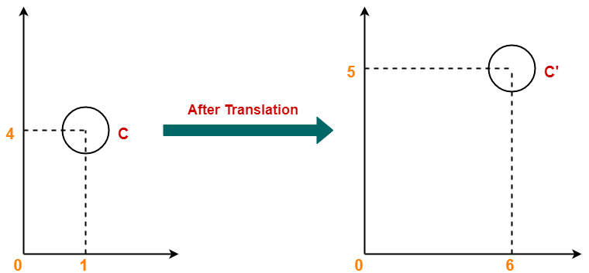
Thus, New center coordinates of C = (6, 5).

Slide 8
Problem-02:
Given a square with coordinate points A(0, 3), B(3, 3), C(3, 0), D(0, 0). Apply the translation with distance 1 towards X axis and 1 towards Y axis. Obtain the new coordinates of the square.
Solution-
Old coordinates of the square = A (0, 3), B(3, 3), C(3, 0), D(0, 0)
Translation vector = (T_{x}, T_{y}) = (1, 1)
For Coordinates A(0, 3)
Let the new coordinates of corner A = (X_{new}, Y_{new}).
Applying the translation equations, we have-
X_{new} = X_{old} + T_{x} = 0 + 1 = 1
Y_{new} = Y_{old} + T_{y} = 3 + 1 = 4
Thus, New coordinates of corner
A = (1, 4).
For Coordinates B(3, 3)
Let the new coordinates of corner
B = (X_{new}, Y_{new}).
Applying the translation equations, we have-
X_{new} = X_{old} + T_{x} = 3 + 1 = 4
Y_{new} = Y_{old} + T_{y} = 3 + 1 = 4
Thus, New coordinates of corner
B = (4, 4).

Slide 9
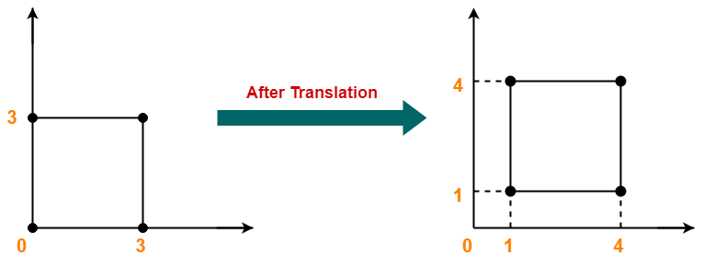
For Coordinates C(3, 0)
Let the new coordinates of corner
C = (X_{new}, Y_{new}).
Applying the translation equations, we have-
X_{new} = X_{old} + T_{x} = 3 + 1 = 4
Y_{new} = Y_{old} + T_{y} = 0 + 1 = 1
Thus, New coordinates of corner
C = (4, 1).
For Coordinates D(0, 0)
Let the new coordinates of corner
D = (X_{new}, Y_{new}).
Applying the translation equations, we have-
X_{new} = X_{old} + T_{x} = 0 + 1 = 1
Y_{new} = Y_{old} + T_{y} = 0 + 1 = 1
Thus, New coordinates of corner
D = (1, 1).
Thus, New coordinates of the square = A (1, 4), B(4, 4), C(4, 1), D(1, 1).

Slide 10
2D Rotation in Computer Graphics-
In Computer graphics,
2D Rotation is a process of rotating an object with respect to an angle in a two dimensional plane.
Rotation is a type of transformation that is very often used in computer graphics and image processing.
Rotation is a process of rotating an object with respect to an angle in a two-dimensional plane.
It is a process of changing the angle of the object which can be clockwise or anticlockwise, while we have to specify the angle of rotation and rotation point. A rotation point is also called a pivot point.
There are two types of rotations according to the direction of the movement of the object. These are:
• Anti-clockwise rotation
• Clockwise rotation
The positive value of the rotation angle rotates an object in an anti-clockwise direction while the negative value of the rotation angle rotates an object in a clockwise direction. When we rotate any object, then every point of that object is rotated by the same angle. For example, a straight line is rotated by the endpoints with the same angle and the line is re-drawn between the new endpoints. Also, the polygon is rotated by shifting every vertex with the help of the same rotational angle. Same for circle also, it can be obtained by center position by the specified angle.

Slide 11
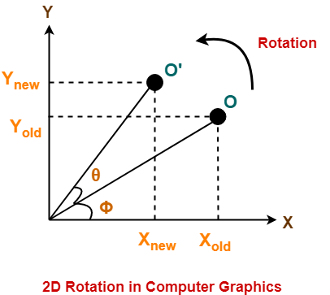
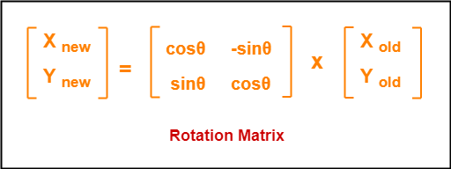
Consider a point object O has to be rotated from
one angle to another in a 2D plane.
Let-
Initial coordinates of the object O = (X_{old}, Y_{old})
Initial angle of the object O with respect to origin = Φ
Rotation angle = θ
New coordinates of the object O after rotation = (X_{new}, Y_{new})
This rotation is achieved by using the following rotation equations-
X_{new} = X_{old} x cosθ – Y_{old} x sinθ
Y_{new} = X_{old} x sinθ + Y_{old} x cosθ
In Matrix form, the above rotation
equations may be represented as-

Slide 12
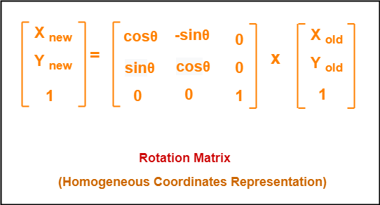
For homogeneous coordinates, the above rotation matrix may be represented as a 3 x 3 matrix as-

Slide 13
Problem-01:
Given a line segment with starting point as (0, 0) and ending point as (4, 4). Apply 30 degree rotation anticlockwise direction on the line segment and find out the new coordinates of the line.
Solution:- We rotate a straight line by its end points with the same angle. Then, we re-draw a line between the new end points.
Old ending coordinates of the line = (X_{old}, Y_{old}) = (4, 4)
Rotation angle = θ = 30º
Let new ending coordinates of the line after rotation = (X_{new}, Y_{new}).
Applying the rotation equations, we have-
X_{new} = X_{old} x cosθ – Y_{old} x sinθ
= 4 x cos30º – 4 x sin30º
= 4 x (√3 / 2) – 4 x (1 / 2)
= 2√3 – 2
= 2(√3 – 1)
= 2(1.73 – 1)
= 1.46
Y_{new} = X_{old} x sinθ + Y_{old} x cosθ
= 4 x sin30º + 4 x cos30º
= 4 x (1 / 2) + 4 x (√3 / 2)
= 2 + 2√3
= 2(1 + √3) = 2(1 + 1.73) = 5.46
Thus, New ending coordinates of the line after rotation = (1.46, 5.46).

Slide 14
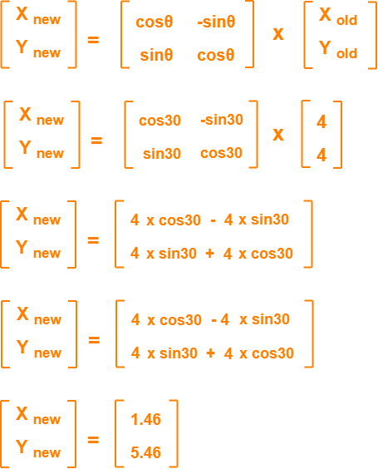
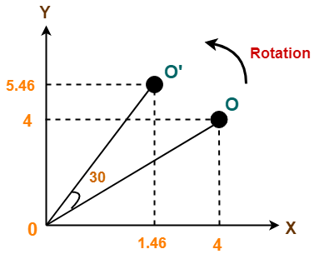
Alternatively,
In matrix form, the new ending coordinates of the line after rotation may be obtained as-
Thus, New ending coordinates of the line after rotation = (1.46, 5.46).

Slide 15
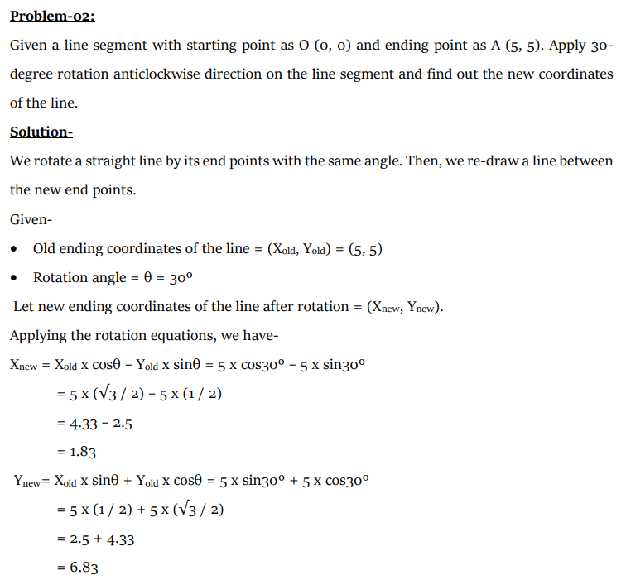
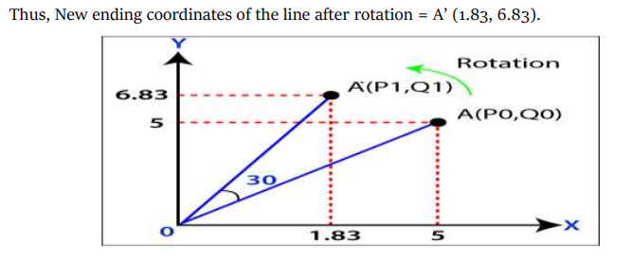

Slide 16
Problem-03:
Given a triangle with corner coordinates (0, 0), (1, 0) and (1, 1). Rotate the triangle by 90 degree anticlockwise direction and find out the new coordinates.
Solution:- We rotate a polygon by rotating each vertex of it with the same rotation angle.
Old corner coordinates of the triangle = A (0, 0), B(1, 0), C(1, 1)
Rotation angle = θ = 90º
For Coordinates A(0, 0)
Let the new coordinates of corner A after rotation = (X_{new}, Y_{new}).
Applying the rotation equations, we have-
X_{new}
= X_{old} x cosθ – Y_{old} x sinθ
= 0 x cos90º – 0 x sin90º
= 0
Y_{new}
= X_{old} x sinθ + Y_{old} x cosθ
= 0 x sin90º + 0 x cos90º
= 0
Thus, New coordinates of corner A after rotation = (0, 0).
For Coordinates B(1, 0)
The new coordinates of corner B after rotation = (X_{new}, Y_{new}).
X_{new}
= X_{old} x cosθ – Y_{old} x sinθ
= 1 x cos90º – 0 x sin90º
= 0
Y_{new}
= X_{old} x sinθ + Y_{old} x cosθ
= 1 x sin90º + 0 x cos90º
= 1 + 0
= 1
Thus, New coordinates of corner B after rotation = (0, 1).

Slide 17
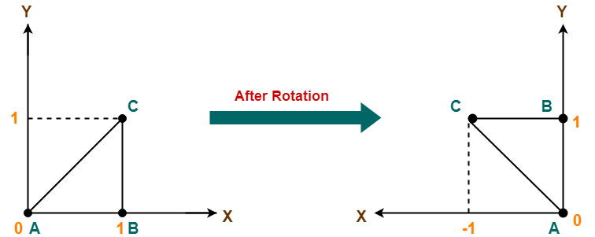
For Coordinates C(1, 1)
The new coordinates of corner C after rotation = (X_{new}, Y_{new}).
X_{new}
= X_{old} x cosθ – Y_{old} x sinθ
= 1 x cos90º – 1 x sin90º
= 0 – 1
= -1
Y_{new}
= X_{old} x sinθ + Y_{old} x cosθ
= 1 x sin90º + 1 x cos90º
= 1 + 0
= 1
Thus, New coordinates of corner C after rotation = (-1, 1).
Thus, New coordinates of the triangle after rotation = A (0, 0), B(0, 1), C(-1, 1).

Slide 18
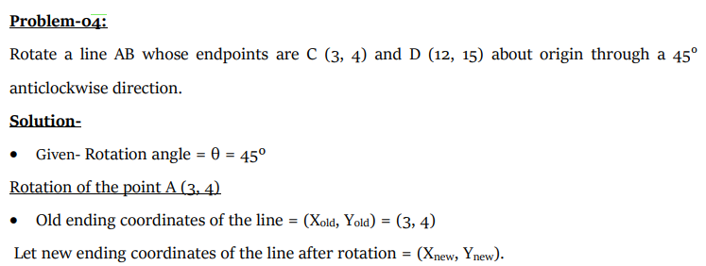
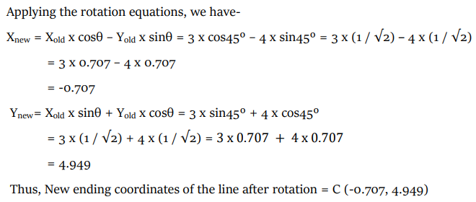

Slide 19
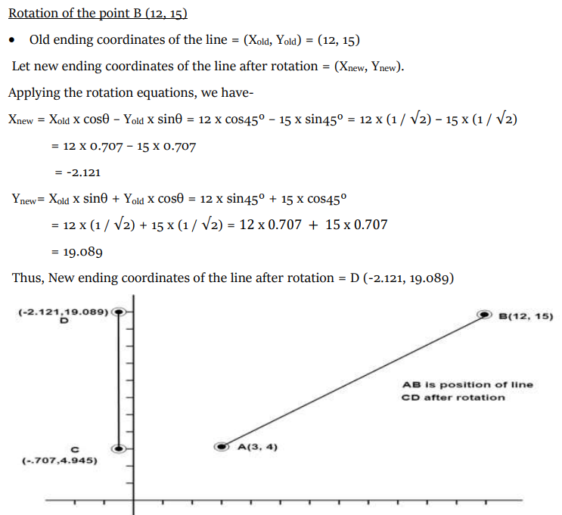

Slide 20
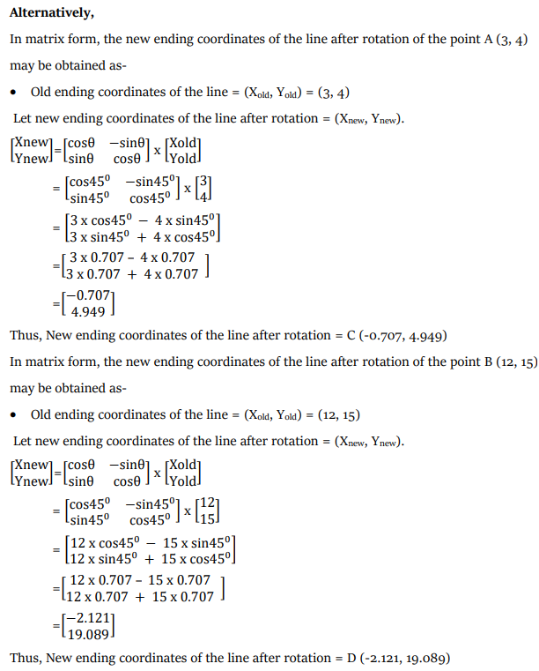

Slide 21
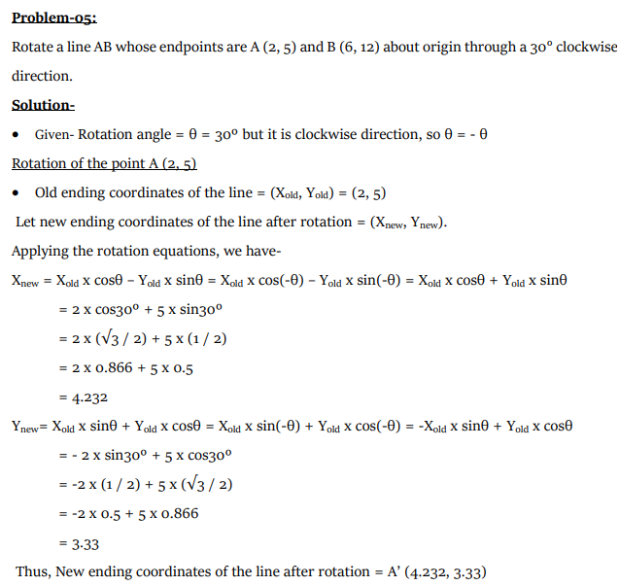

Slide 22
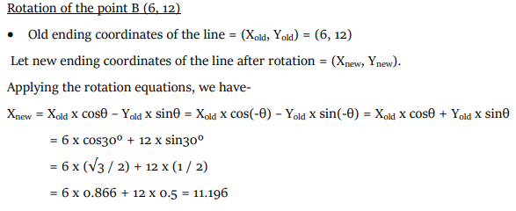
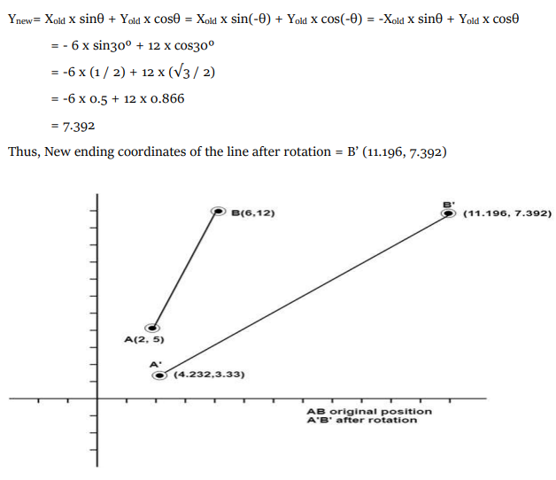

Slide 23
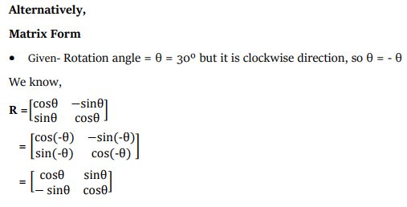
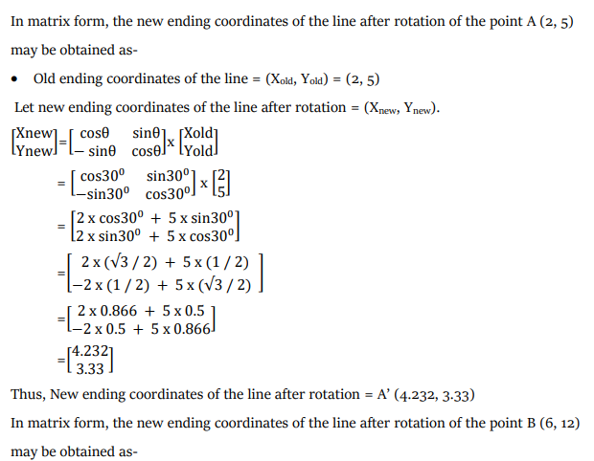

Slide 24
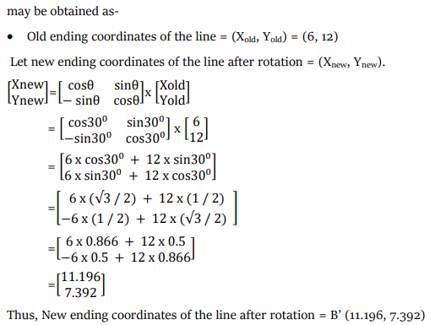

Slide 25
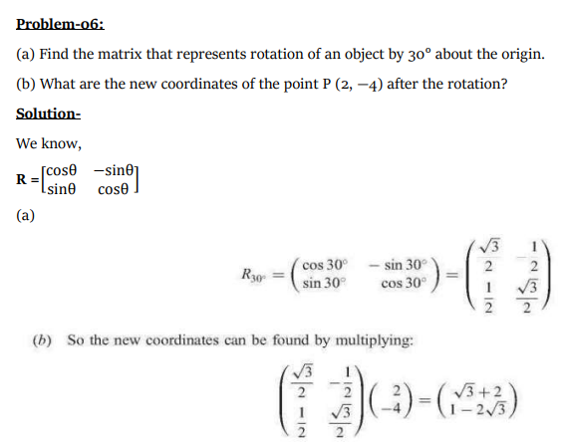

Slide 26
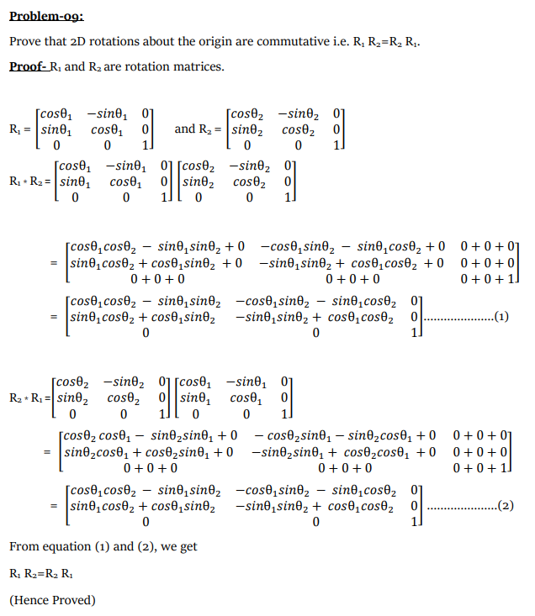
Problem-07

Slide 27
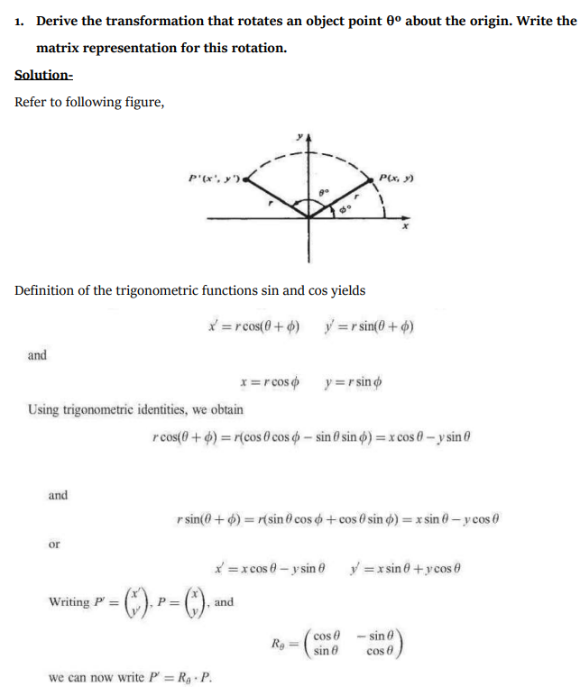

Slide 28
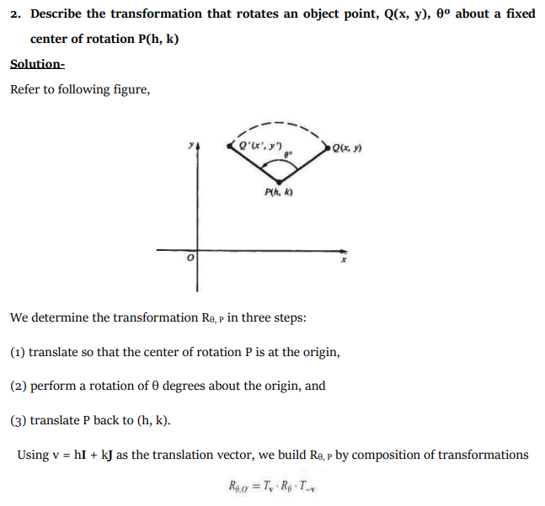

Slide 29
2D Scaling in Computer Graphics-
In computer graphics, scaling is a process of modifying or altering the size of objects.
Scaling may be used to increase or reduce the size of object.
Scaling subjects the coordinate points of the original object to change.
Scaling factor determines whether the object size is to be increased or reduced.
If scaling factor > 1, then the object size is increased.
If scaling factor < 1, then the object size is reduced.
Consider a point object O has to be scaled in a 2D plane. Let-
Initial coordinates of the object O = (X_{old}, Y_{old})
Scaling factor for X-axis = S_{x}
Scaling factor for Y-axis = S_{y}
New coordinates of the object O after scaling = (X_{new}, Y_{new})
This scaling is achieved by using the following scaling equations-
X_{new} = X_{old} x S_{x}
Y_{new} = Y_{old} x S_{y}

Slide 30
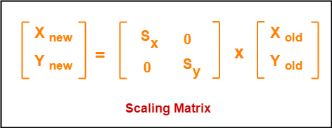
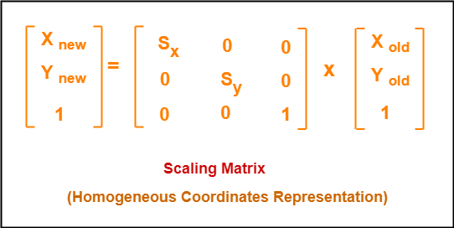
In Matrix form, the above scaling equations may be represented as-
For homogeneous coordinates, the above scaling matrix may be represented as a 3 x 3 matrix as-

Slide 31
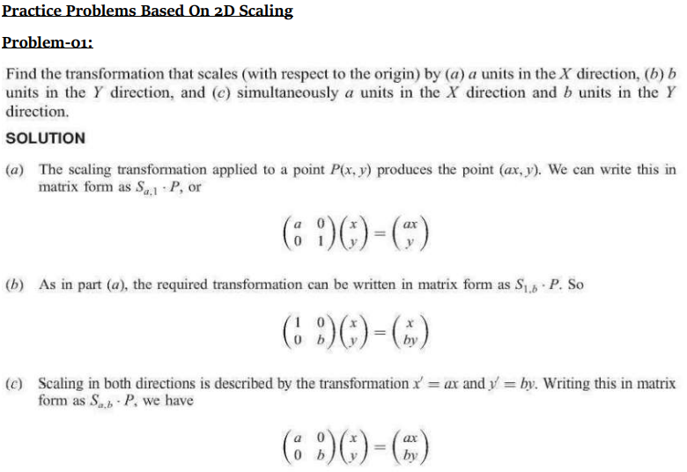

Slide 32
Problem-02:
Given a square object with coordinate points A(0, 3), B(3, 3), C(3, 0), D(0, 0). Apply the scaling parameter 2 towards X axis and 3 towards Y axis and obtain the new coordinates of the object.
Solution-
Given-
Old corner coordinates of the square = A (0, 3), B(3, 3), C(3, 0), D(0, 0)
Scaling factor along X axis = 2
Scaling factor along Y axis = 3
For Coordinates A(0, 3)
Let the new coordinates of corner A after scaling = (X_{new}, Y_{new}).
Applying the scaling equations, we have-
X_{new} = X_{old} x S_{x} = 0 x 2 = 0
Y_{new} = Y_{old} x S_{y} = 3 x 3 = 9
Thus, New coordinates of corner A after scaling = (0, 9).
For Coordinates B(3, 3)
Let the new coordinates of corner B after scaling = (X_{new}, Y_{new}).
Applying the scaling equations, we have-
X_{new} = X_{old} x S_{x} = 3 x 2 = 6
Y_{new} = Y_{old} x S_{y} = 3 x 3 = 9
Thus, New coordinates of corner B after scaling = (6, 9).

Slide 33
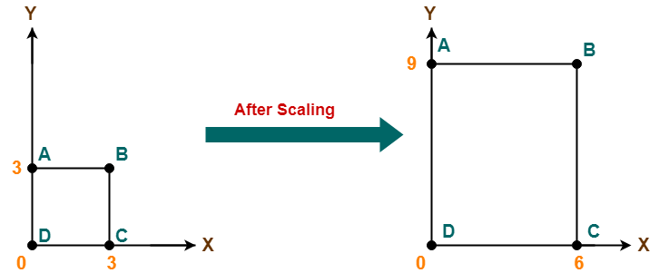
For Coordinates D(0, 0)
Let the new coordinates of corner D after scaling = (X_{new}, Y_{new}).
Applying the scaling equations, we have-
X_{new} = X_{old} x S_{x} = 0 x 2 = 0
Y_{new} = Y_{old} x S_{y} = 0 x 3 = 0
Thus, New coordinates of corner D after scaling = (0, 0).
Thus, New coordinates of the square after scaling = A (0, 9), B(6, 9), C(6, 0), D(0, 0).
For Coordinates C(3, 0)
Let the new coordinates of corner C after scaling = (X_{new}, Y_{new}).
Applying the scaling equations, we have-
X_{new} = X_{old} x S_{x} = 3 x 2 = 6
Y_{new} = Y_{old} x S_{y} = 0 x 3 = 0
Thus, New coordinates of corner C after scaling = (6, 0).

Slide 34
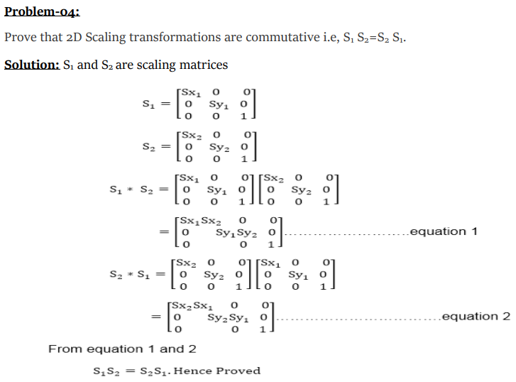
Problem-03:

Slide 35
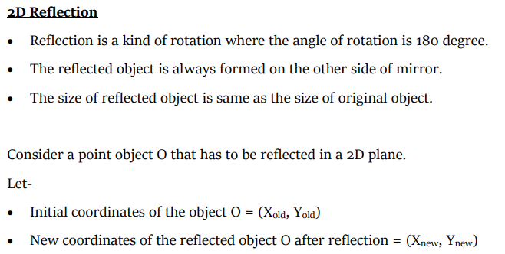

Slide 36
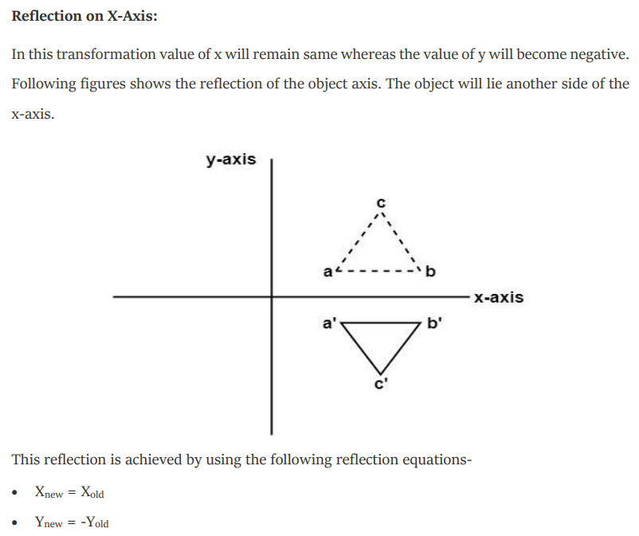

Slide 37
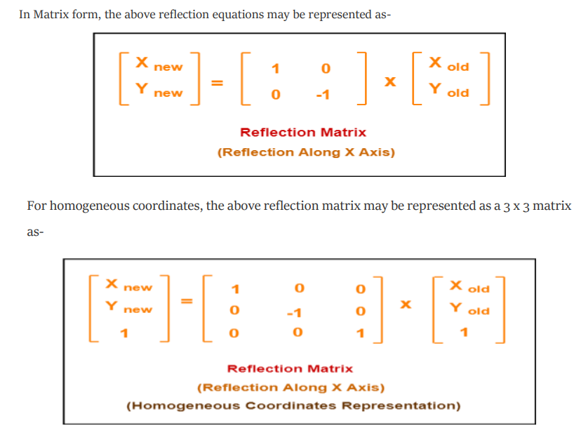

Slide 38
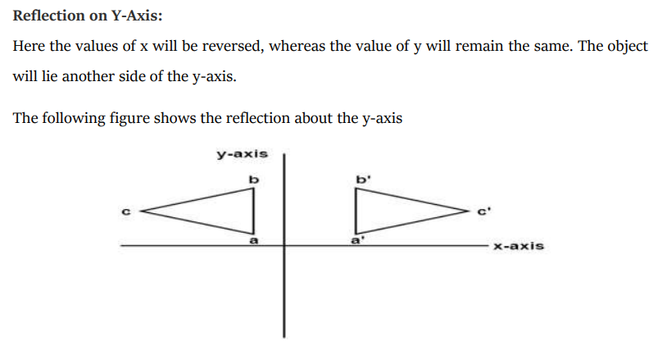
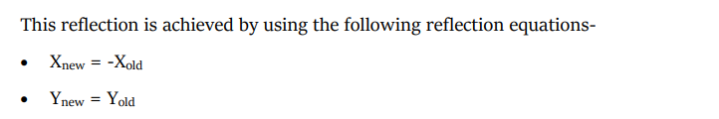

Slide 39
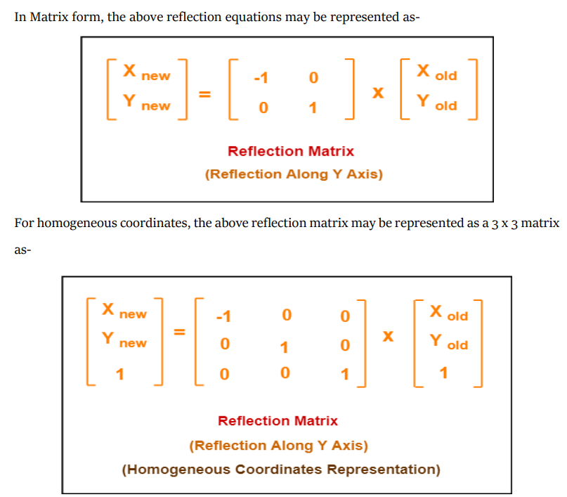

Slide 40
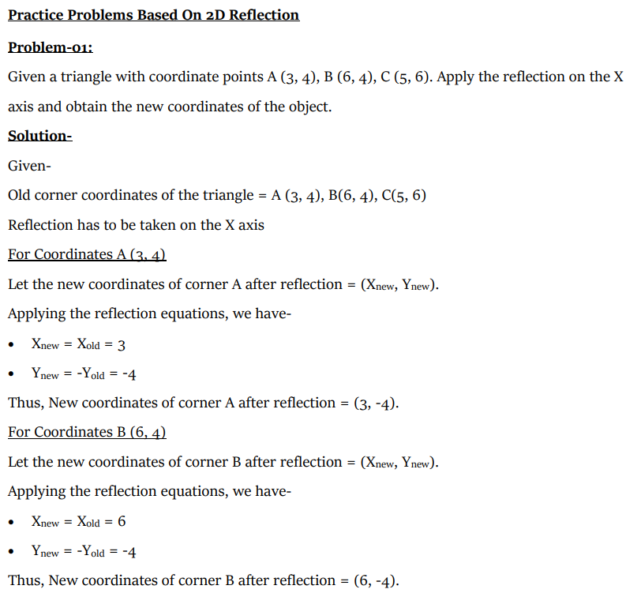

Slide 41
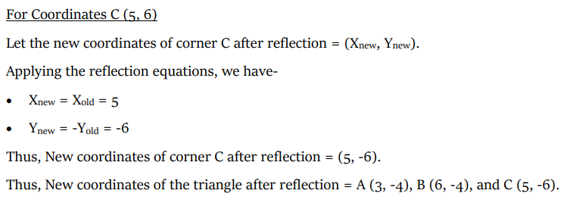
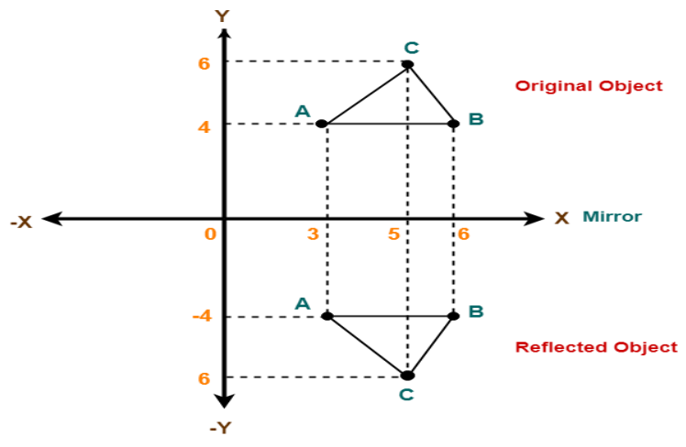

Slide 42
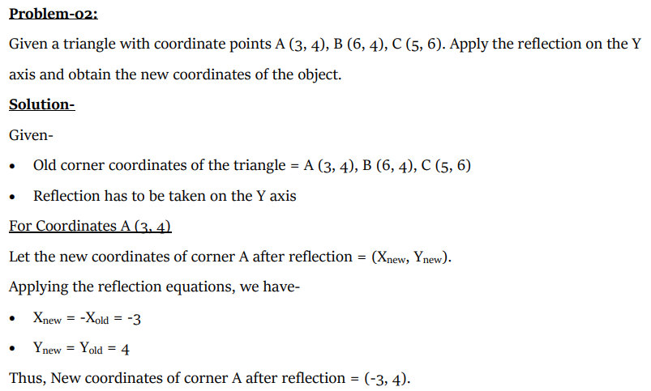

Slide 43
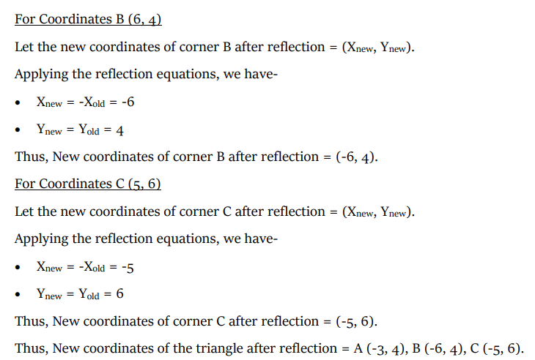
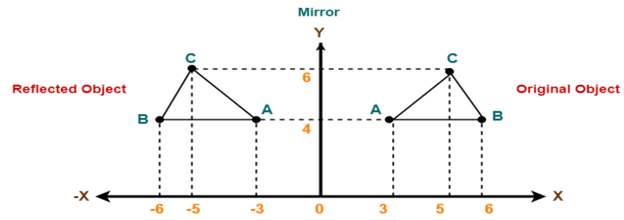

Slide 44
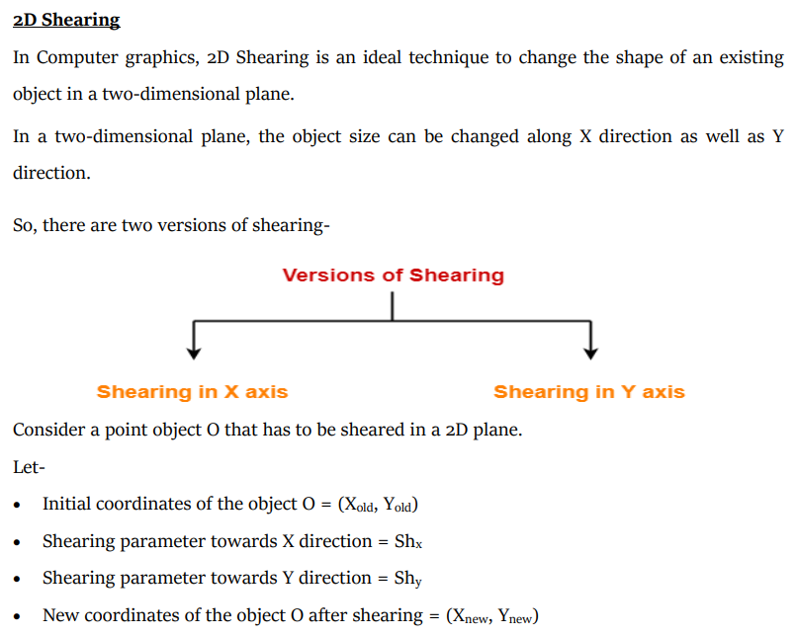

Slide 45
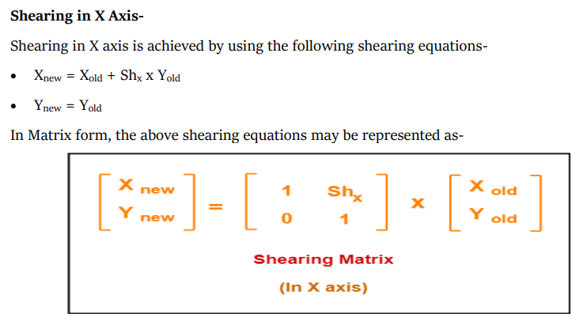
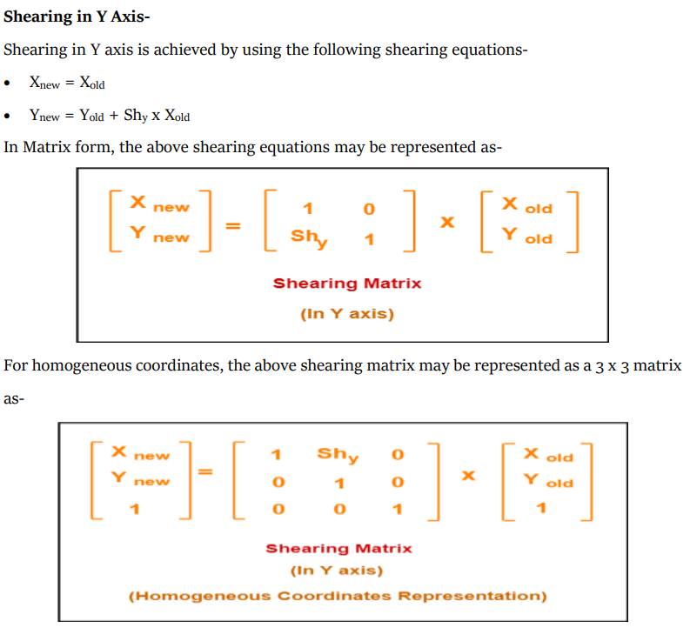
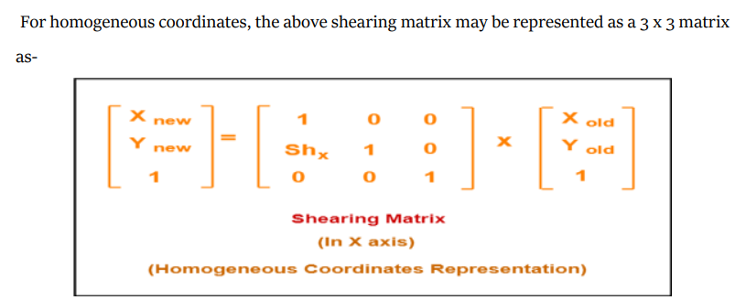

Slide 46


Slide 47




Slide 48


Slide 49


Slide 50




Slide 51




Slide 52


Note: The above finale result of Fig.4, that we get after applying all transformation one after one in a serial manner.

